Slide 1




SOUQPASS
Jan 09,2024

Slide 2






THE IDEA OF ESTABLISHING COOPERATIVE BANK OF OROMIA
The Cooperative Bank of Oromia was established to address rural financial challenges, including poor savings culture, exploitative informal lending, and the need to support cooperative institutions and farmers in country .
Formation
The Cooperative Bank of Oromia was created to address rural financing needs, with support from NGOs like ACDI VOCA and Self-help international.
PROJECT OFFICE
The Project Office was established to oversee the bank's business viability, create startup guidelines and regulations, handle legal incorporation, and manage day-to-day operations.
ESTABLISHMENT
Cooperative Bank of Oromia filled the financial service gap for rural farmers and cooperatives in Oromia, commencing operations on March 8, 2005, with a paid-up share capital of 112 million birr. It has expanded with multiple branches across the country.
©Cooperative Bank of Oromia

Slide 3

We root our foundation in communities to provide banking solutions that create greater customer experience with emphasis to cooperatives and agro-based businesses through proper use of human resource and up-to-date technologies to maximize stakeholders’ value.
First bank of its kind in the country (cooperative owned)
Owned by millions of farmers,
Unique business model assisting cooperative movement
Integrity
Customer Satisfaction
Learning Organization
Team work
Cost Consciousness
Concern for Community
Due focus to rural areas (80% of its branch footprint positioned in outlying areas),
To be the leading private bank in Ethiopia by 2025
Recognizes socio-cultural values where respect for cultural attributes
and modern banking services meet.
©Cooperative Bank of Oromia

Slide 4
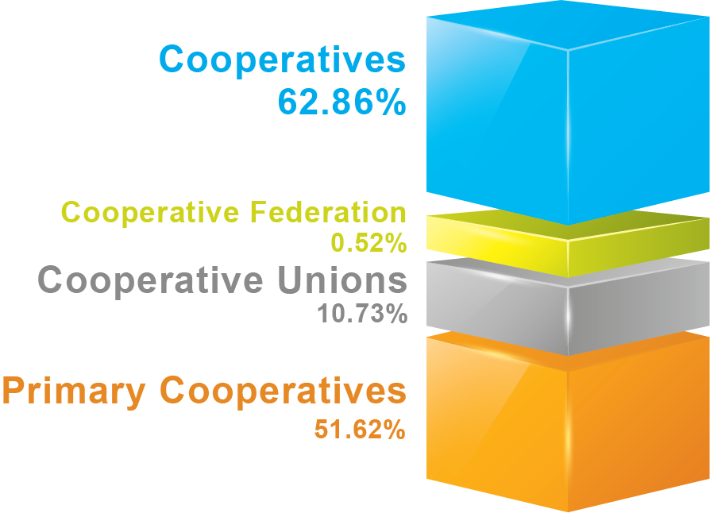

Ownership
Coop Bank
©Cooperative Bank of Oromia

Slide 5
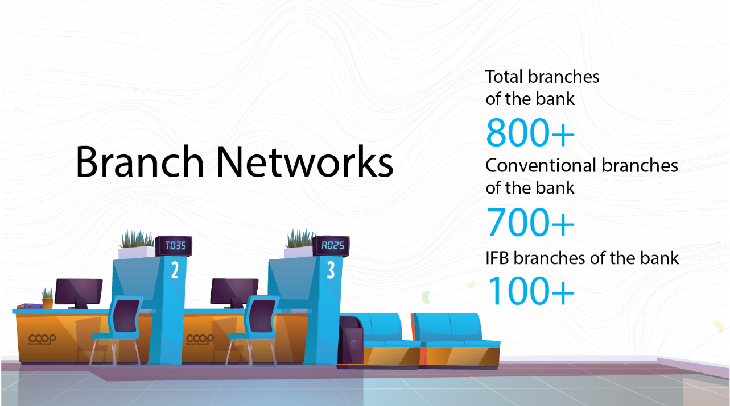

Slide 6


What Do YOU Need?
Sales(Employee)
Expense?
Store ( shop)?
Profit?
Financing ?
Scale Up?
©Cooperative Bank of Oromia

Slide 7

Traditional Way Of Business
Write Down what you sell and buy.
Not knowing where your business is going.
Unable to provide real time data on business performance
Managing your Sales just by word / trust base
Talking in Person (Talking directly to customers)
Using Money ( only Cash )
Availability only is areas you have shops
Only nearby know about your business
Store is open at certain times.
Not be able to provide about your business on paper
©Cooperative Bank of Oromia

Slide 8
What Banks Need For Loans
Plan for Your Business
Money Details
Why You Need the Loan
01
02
Share details about how much money your business makes.
03
Explain why you need the loan for your business.
Have a simple plan for your business, saying what you want to do and how.
Business Papers:
Your Contribution
Bank Statements
04
Show any important papers for your business, like licenses or permits.
05
Sometimes, you might need to put in some of your own money too.
06
Provide recent papers from your business bank account.
Your Experience
Collateral
07
08
Guaranty in case you don’t pay
Tell the bank about your experience in running this type of business.
©Cooperative Bank of Oromia

Slide 9

Digital Lending
Digital lending is providing loans through online platforms that use technology to bring together borrowers who are underserved by traditional lenders
These underserved borrowers range from small and medium enterprises (SMEs) to individuals
The key players in the digital lending ecosystem are;
Individuals/ Consumers
Partner
The borrowers: who could be individuals or small or medium businesses,
The lenders: Bank, and
The digital lending platform acts as a facilitator that connects the 3 key players
Bank
Small and medium Businesses
©Cooperative Bank of Oromia

Slide 10

Key Aspect/Components of
Digital Lending:
Digital Channel – Mobile App or Laptop
Use of Digitized Data
Focus on Customer Experience & Customer Engagement
Seamless
©Cooperative Bank of Oromia

Slide 11


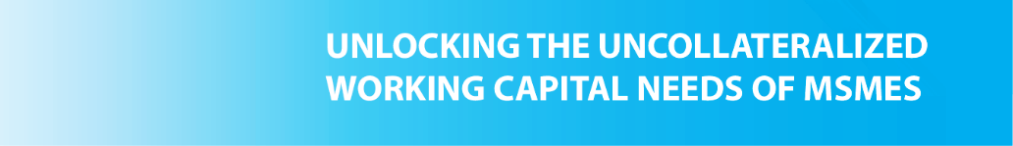
We have collateral-free financial services to a diverse range of MSMEs and informal groups. Leveraging Michu, our digital loan platform, we aim to unlock new opportunities for these underserved segments.
Proposal Details:
1. Targeted Financial Inclusion:
Our collaboration focuses on extending financial inclusivity to different types of MSMEs and informal groups.
2. Collateral-Free Financing:
With Michu, we offer collateral-free loans, ensuring accessibility and convenience.
3. Digital Empowerment:
Michu's digital platform streamlines the loan process, making it efficient and user-friendly.
©Cooperative Bank of Oromia

Slide 12

What do you know About Souq pass?
©Cooperative Bank of Oromia

Slide 13


















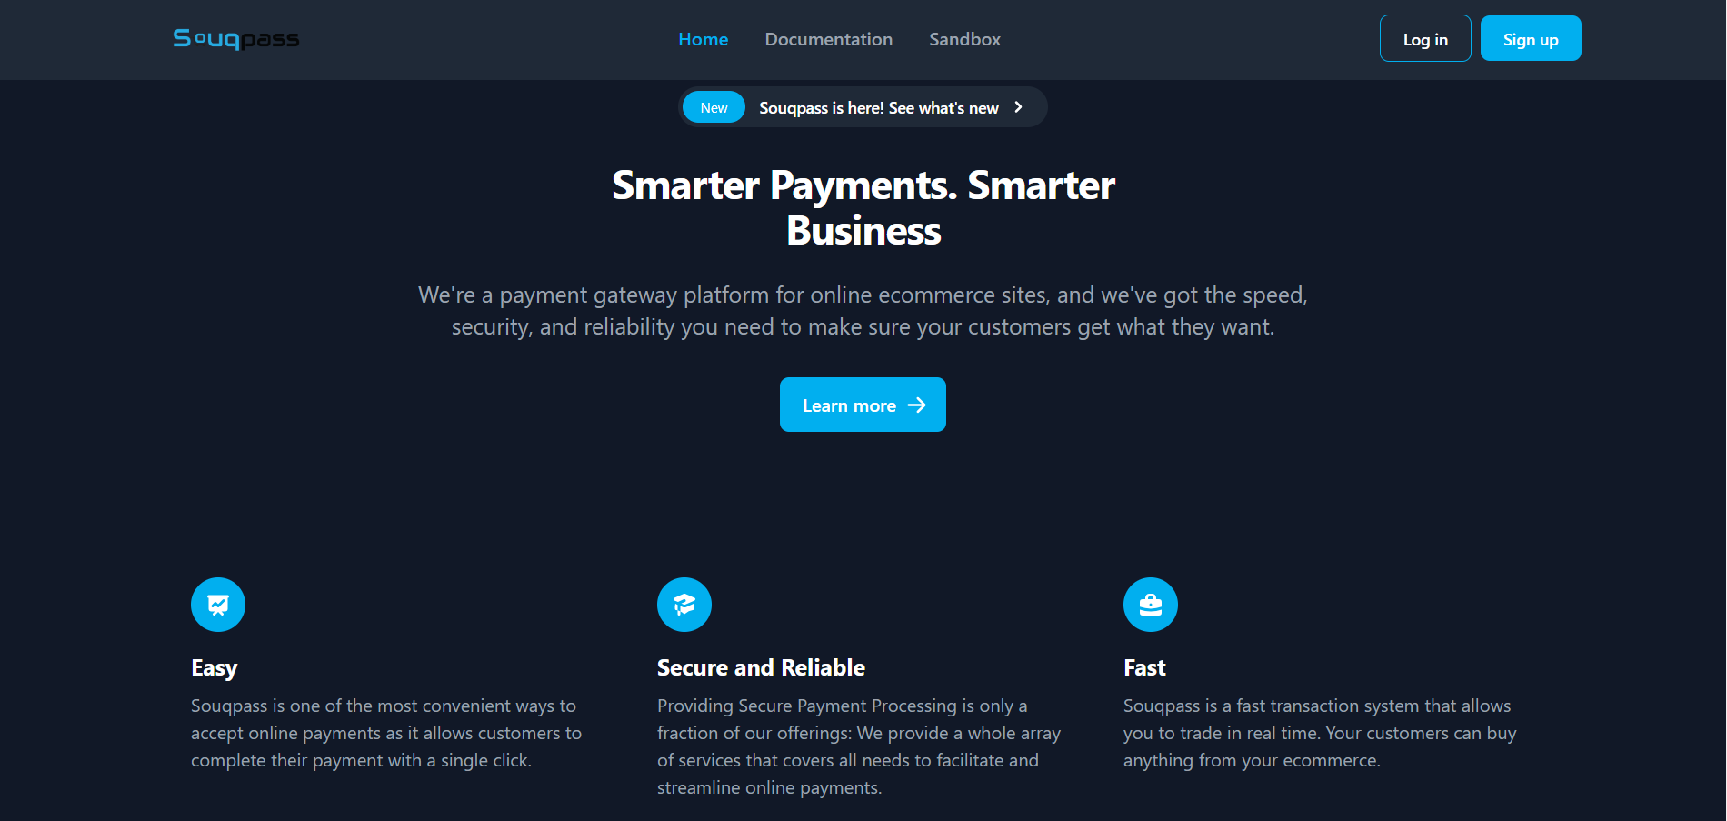
Inventory management
Sales and Seles person management
Payment get way
Loan/ financial RBF and BNPL
Expense management system
Reporting and alerting each stack ,
Report Revenue and profitability of it business
Other
The Souq Pass product is a web application that has digitalized the work of MSME and Small business with standing in a group with RBF financial contributions for various purposes

Slide 14

What is inventory management?
Inventory management, a critical element of the supply chain, is the tracking of inventory from manufacturers to warehouses and from these facilities to a point of sale.
The goal of inventory management is to have the right products in the right place at the right time.
Inventory management requires inventory visibility — knowing when to order, how much to order and where to store stock.
©Cooperative Bank of Oromia

Slide 15
Benefits of Inventory Management
The two main benefits of inventory management are that it ensures you’re able to fulfill incoming or open orders and raises profits. Inventory management also:
Saves Money: Understanding stock trends means you see how much of and where you have something in stock so you’re better able to use the stock you have.
Improves Cash Flow: With proper inventory management, you spend money on inventory that sells, so cash is always moving through the business.
Satisfies Customers: One element of developing loyal customers is ensuring they receive the items they want without waiting.
©Cooperative Bank of Oromia

Slide 16
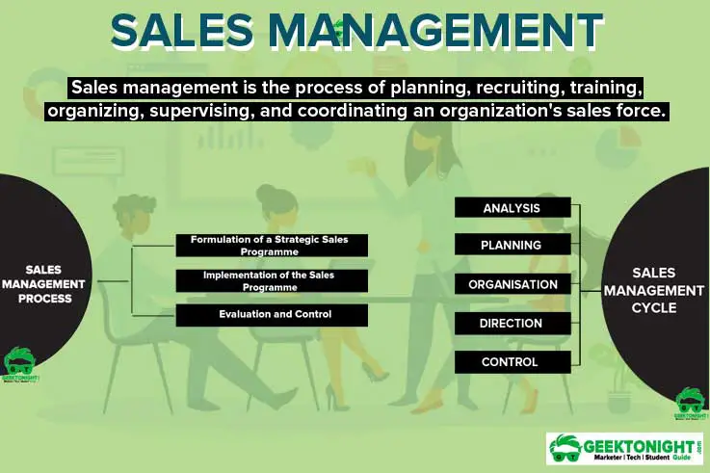
sales and salesperson management,
©Cooperative Bank of Oromia

Slide 17


Integrated payment gateways,
Complete the payment with one click
A payment gateway enables to process mobile transfer, card transactions and other forms of electronic payment.
To manage receiving payment directly with out any seamlessly (without additional things )
A payment gateway is like a virtual cash register or POS system.
©Cooperative Bank of Oromia

Slide 18

Expense management system
The Expense Management System helps us keep track of our spending.
It reveals where we're spending the most, so we can figure out if our expenses are too high compared to the money we're
©Cooperative Bank of Oromia

Slide 19
Reporting & Alerting
Revenue Breakdown
Reporting tools provide detailed insights into various revenue sources, highlighting where the money is coming from.
Profitability Analysis
Businesses can use reporting to analyze the profitability of different aspects, helping them focus on successful areas and identify potential challenges.
Strategic Adjustments
Regular reports enable businesses to make strategic adjustments, optimizing operations for better financial outcomes.
Real-time Alerts
Alerting features act as a real-time guardian, notifying stakeholders when specific revenue or profitability thresholds are met or exceeded.
Proactive Decision-making:
Alerts empower businesses to respond promptly to changes, seize opportunities, and address risks, fostering adaptability and resilience.
©Cooperative Bank of Oromia

Slide 20


Financing
Revenue based financing
Buy Now pay later
Purchase order financing
In financial terms, investment is defined as allocating money to assets with a view to gain profit over a period of time.
Investments in economic and financial terms are inter-related where an individual's savings flow into the capital market as financial investment, which are further used as economic investment.
©Cooperative Bank of Oromia

Slide 21
Revenue-based financing
Revenue-based financing, also known as revenue-based lending, royalty-based financing or revenue-based investing, is a type of small-business lending that involves an initial investment from a financing company or equity firm. Then, investors receive a percentage of the business’s monthly revenue on an ongoing basis.
It differs from debt financing in that there is no fixed monthly payment. And unlike equity financing, the borrower doesn’t have to trade any percentage of ownership for capital.
©Cooperative Bank of Oromia

Slide 22
Advantage of revenue based financing (RBF)
Non-dilutive
Founders and directors keep full control over the company. That’s crucial for startups that have the potential for rapid growth but need a cash injection to help get them there.
No personal guarantee needed
Founders and directors don’t need to put forward personal collateral against the loan, making it a less risky option than traditional debt financing.
Loan repayments are flexible
Repayments are based on the performance of your business. If you do well, you pay more. If you don’t do well, you pay less.
Fast-growing companies settle quicker
Companies that grow quicker than expected make repayments quicker too, so they end up giving up less revenue overall
©Cooperative Bank of Oromia

Slide 23
More coming……
©Cooperative Bank of Oromia

Slide 24
እናመሰናለን!
©Cooperative Bank of Oromia

